Slide 1
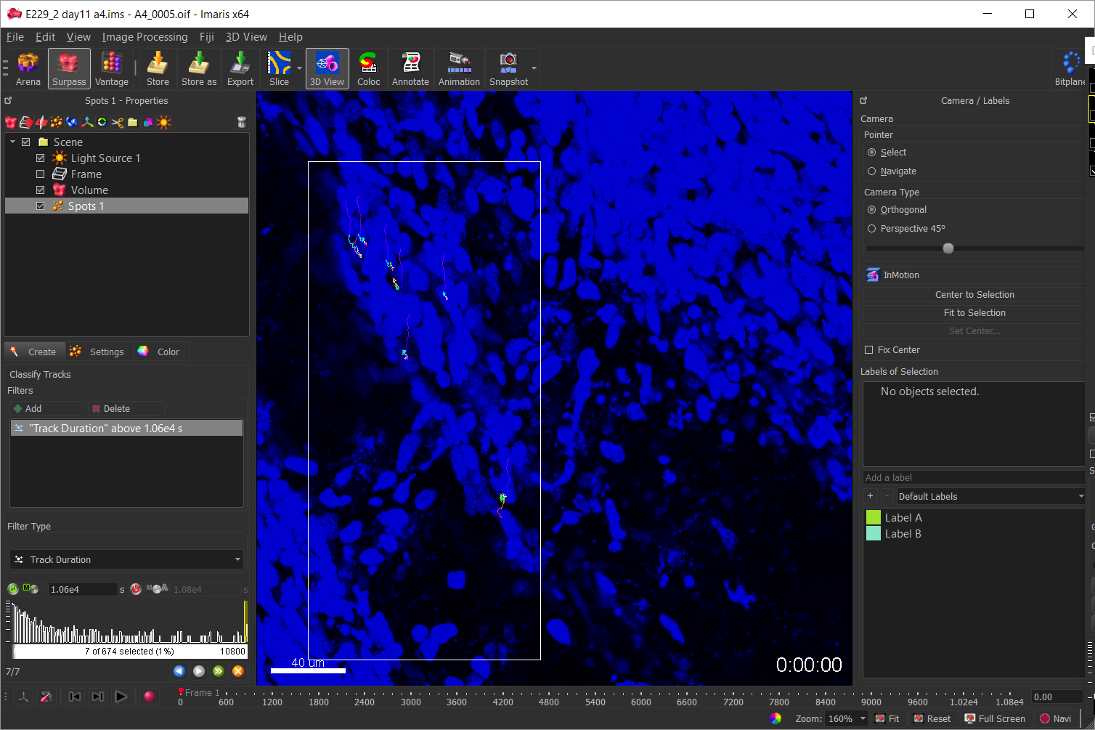
1. DRIFT CORRECTION
Delete spots when done
Use spots
work on ROI, not full movie
Select tracks
encompassing whole movie

Slide 2
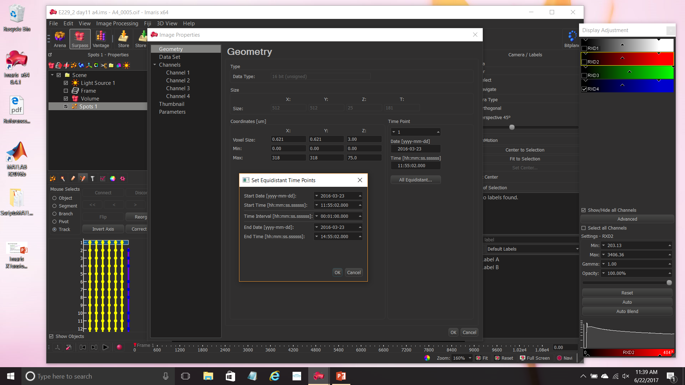
2. X Y Z T ADJUSTMENT (CTRL + I)

Slide 3
3. REMOVE BACKGROUND FROM GREEN SIGNAL
Get rid of bleedthrough from blue (necessary if Simultaneous Acquisition of blue and green was performed)
Perform Baseline Subtraction
Perform Background subtraction
Remove bleedthrough through tracking

Slide 4
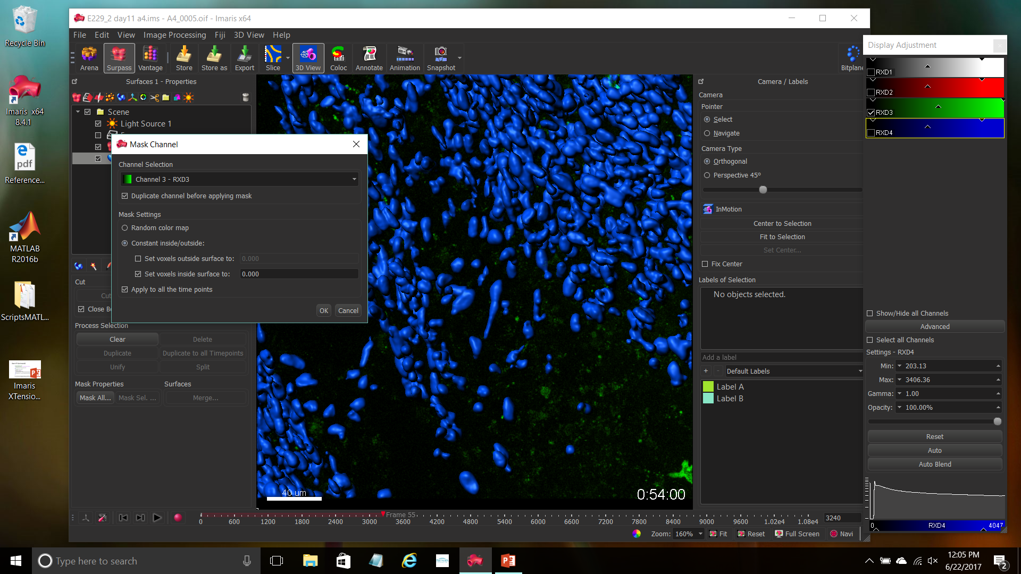
Create surfaces on blue objects (often, tumor nuclei)
3a. REMOVE BLEEDTRHOUGH FROM BLUE
Delete Surfaces when done
Duplicate green channel,
Set fluorescence inside mask to 0

Slide 5
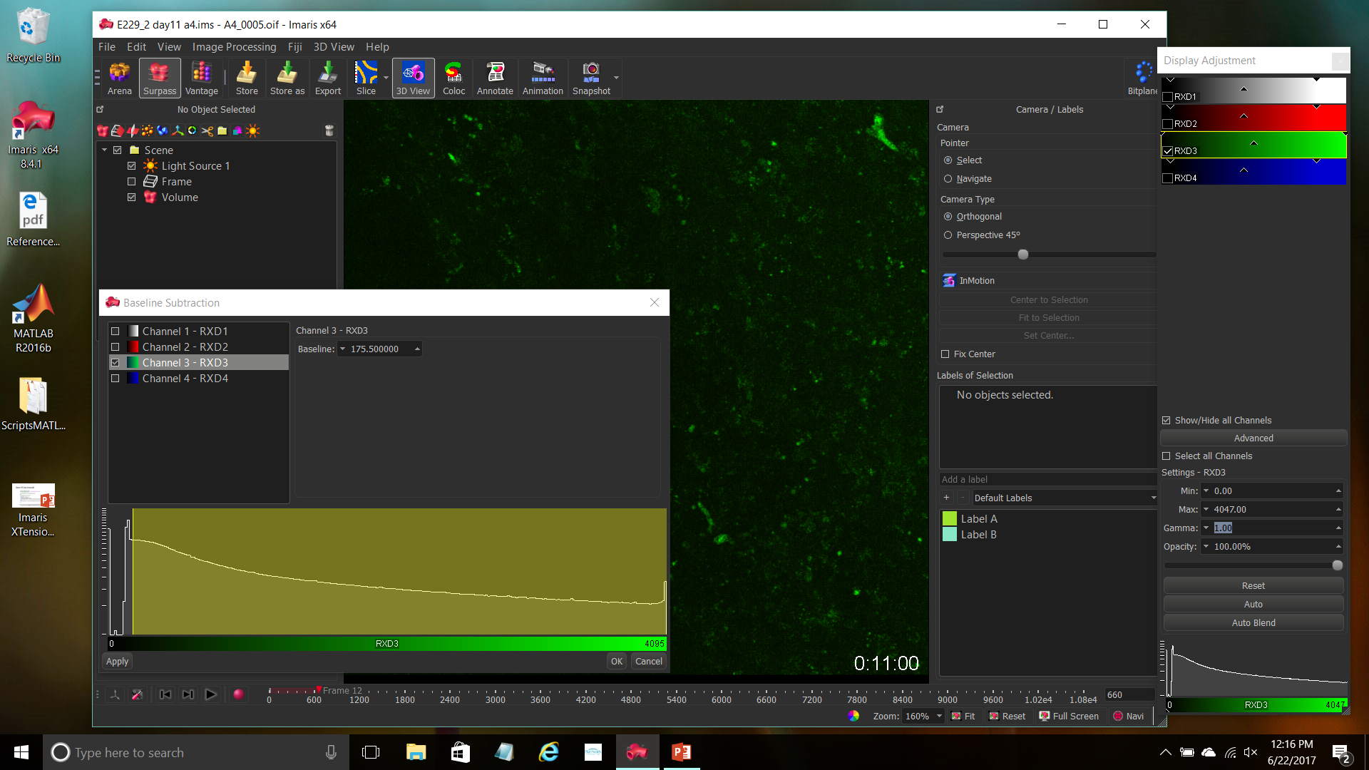
Select
Image processing, Thresholding,
Baseline subtraction
3b. SUBTRACT BASELINE
Exclude first peak (usually autofluorescent pixels)

Slide 6
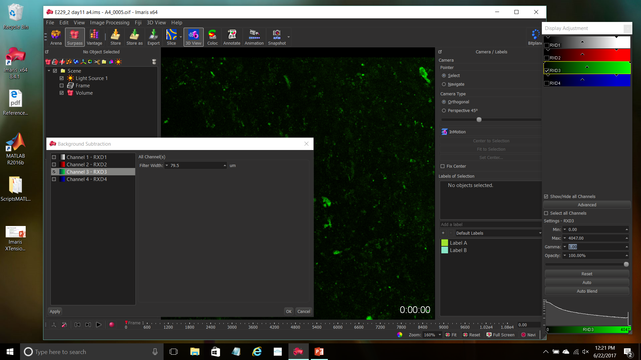
Select
Image processing, Thresholding,
Background subtraction
3c. SUBTRACT BACKGROUND

Slide 7
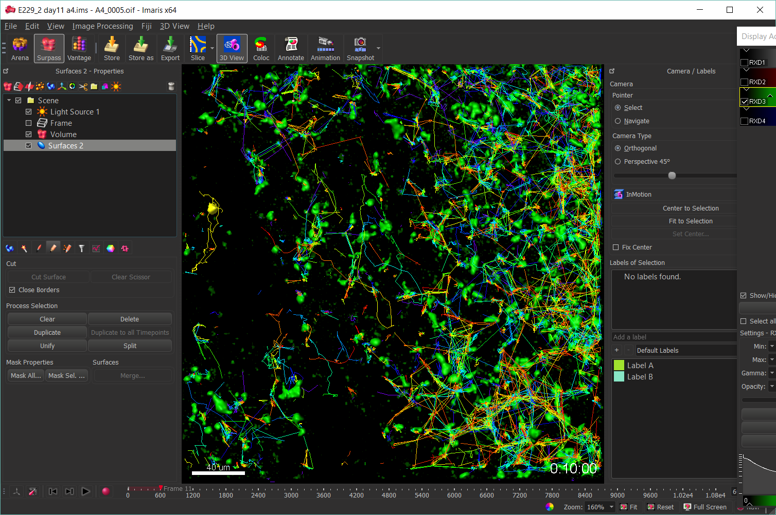
3d. DELETE BACKGROUND OBJECTS THROUGH TRACKING (I)
Track through surfaces.
Background does not matter,
Quality of cell Surfaces and their tracking do.
Select track you are happy with
(this may entail manual refinement),
and duplicate it to save it
Once good tracks are saved, reconstruct Surfaces and tracking to highlight other tracks, and save them

Slide 8
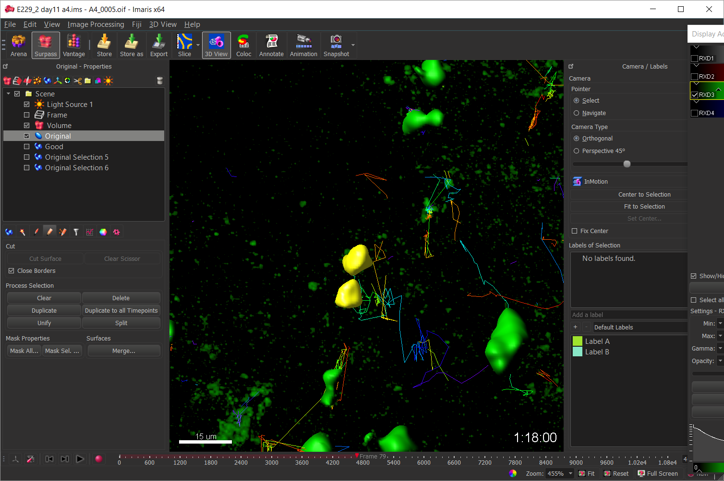
3d. TRACK REFINEMENT (UNIFY SURFACES)
Problem: a cell is represented by two (or more) disjunct surfaces
Solution: Select both surfaces, go to surface edit menu and select “unify”

Slide 9
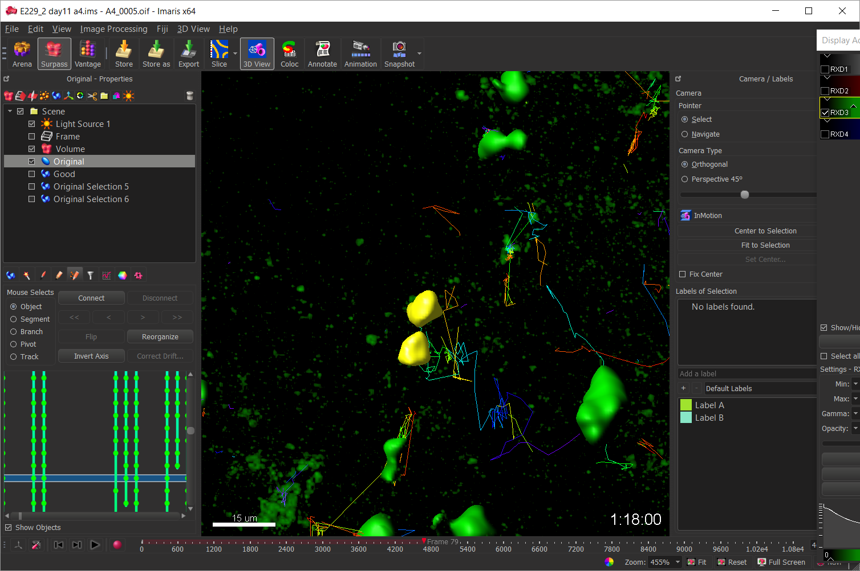
3d. TRACK REFINEMENT (JOIN TRACKS)
Problem: a cell track is broken in two (or more) segments
Solution: Select surfaces at the end and the beginning of two segments, go to track edit menu and select “connect”

Slide 10
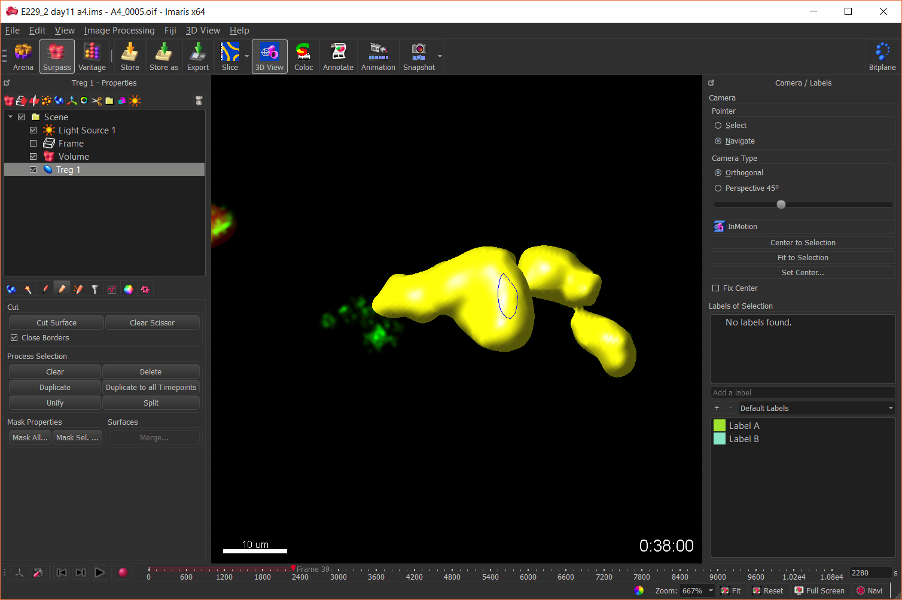
3d. SURFACE REFINEMENT
Problem: Surface gets more stuff than the cell
Solution: trim Surface one by one

Slide 11
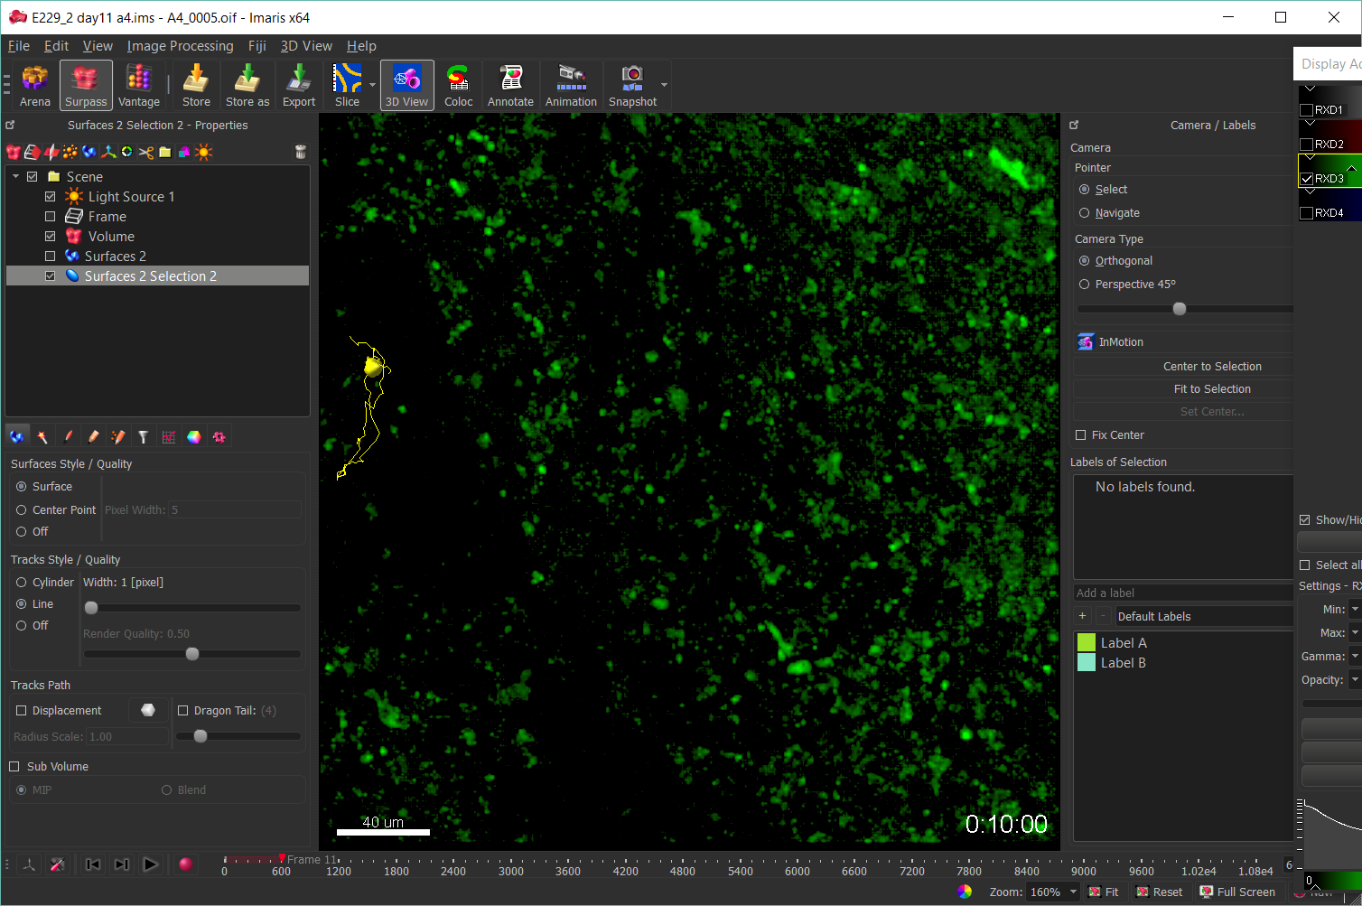
3d. DELETE BACKGROUND OBJECTS THROUGH TRACKING (II)
This is how saved tracks look like

Slide 12
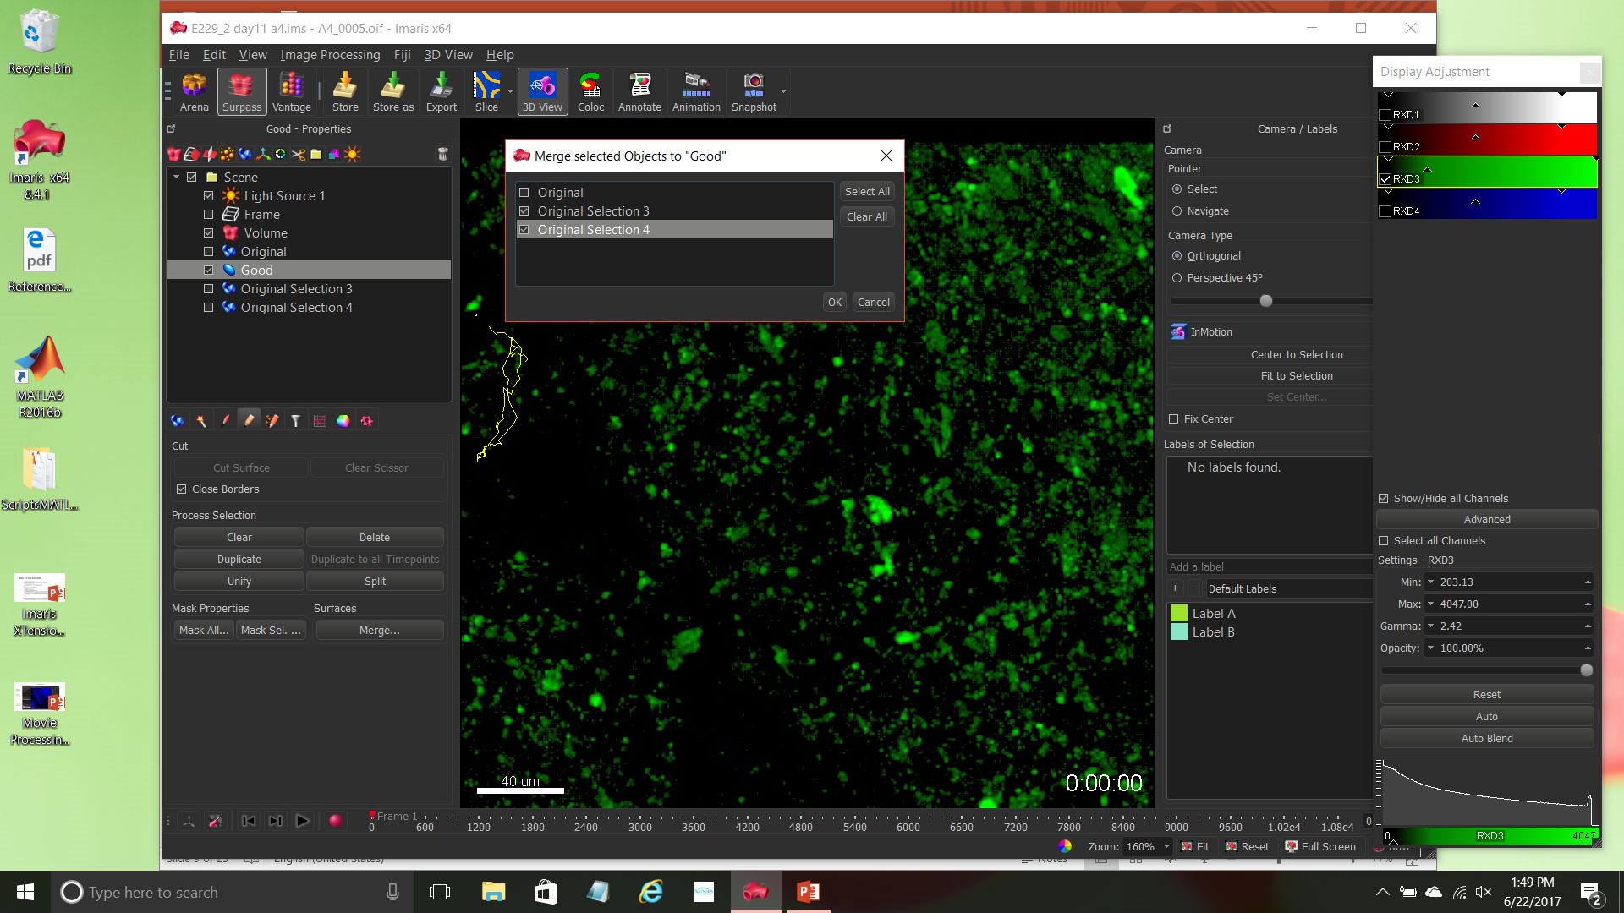
3d. DELETE BACKGROUND OBJECTS THROUGH TRACKING (III)
Merge good tracks into ONE Surface collection
(Just make sure not to merge
Back to “original”)

Slide 13
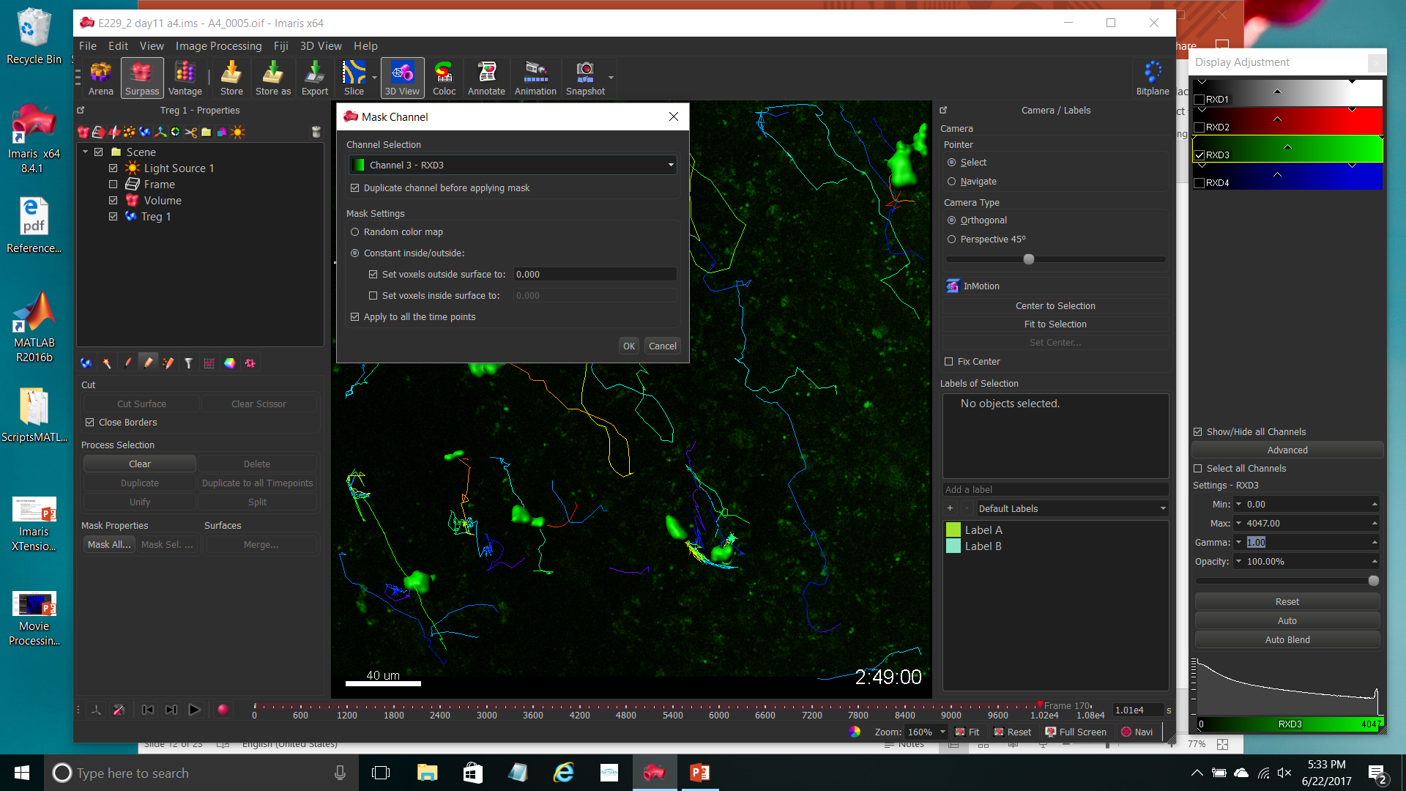
3d. DELETE BACKGROUND OBJECTS THROUGH TRACKING (IV)
Create new channel, based on green, using the surfaces selected through tracking to delete green fluorescence outside of them

Slide 14
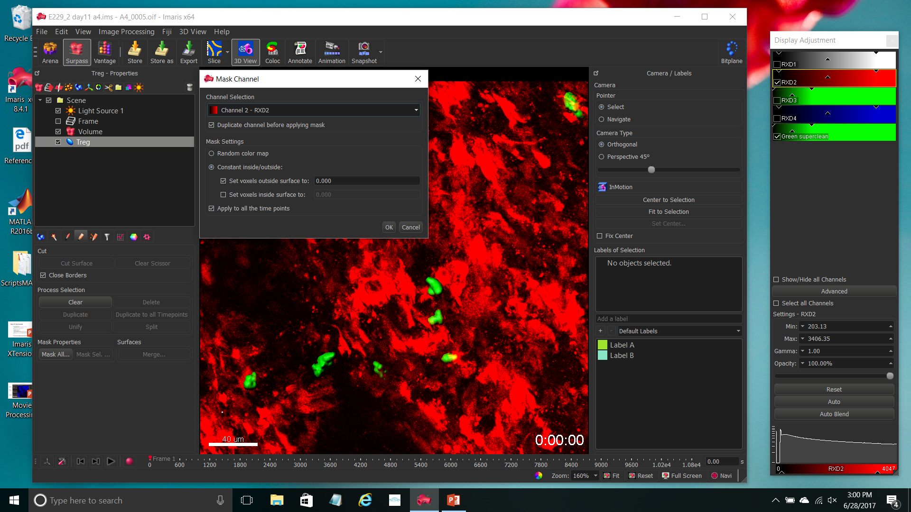
4. SEPARATE RED NUCLEI FROM RED CD11c CELLS
Mask red channel:
NUCLEI is red signal WITHIN green mask
CD11C is red signal OUTSIDE green mask

Slide 15
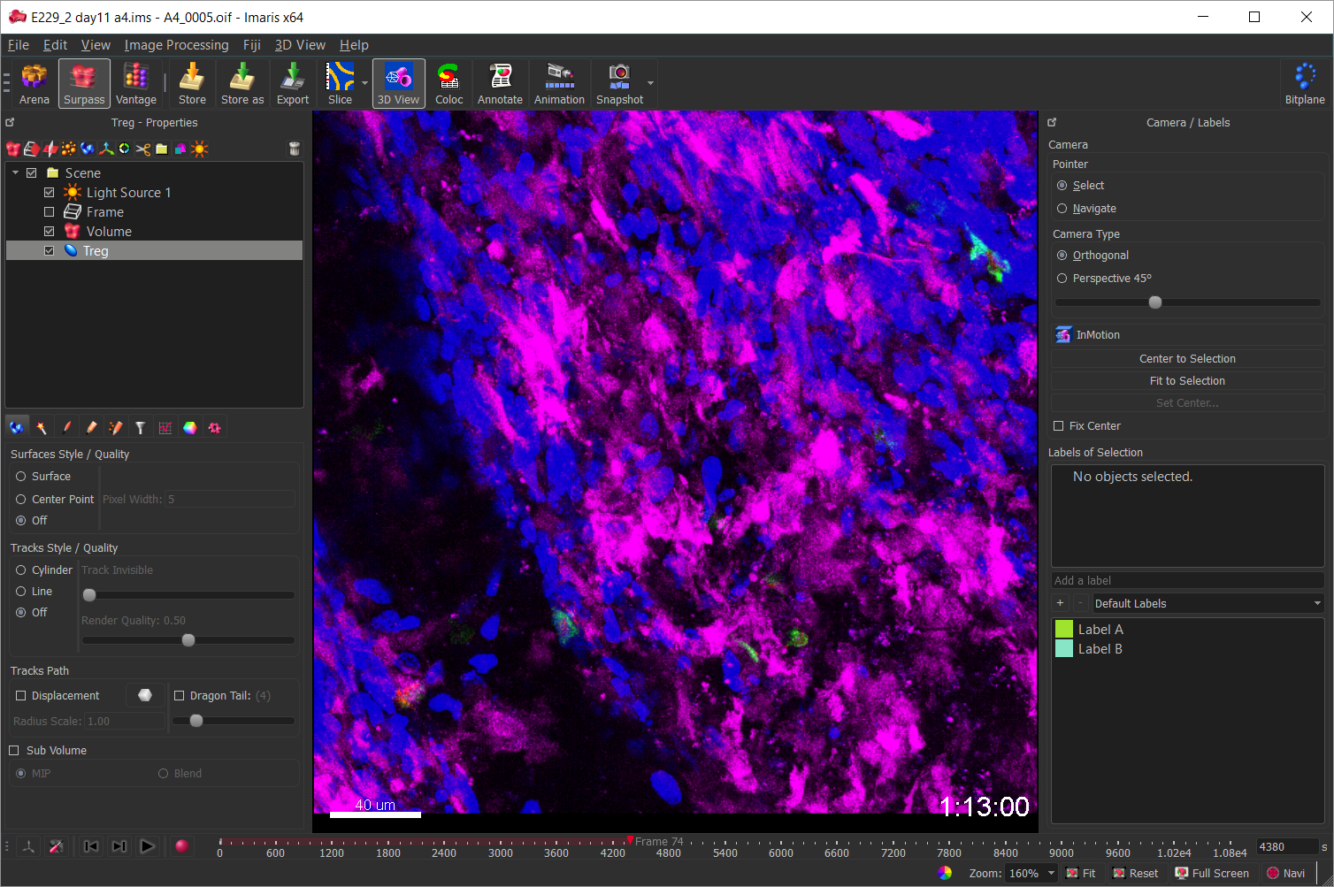
4. END RESULT

Slide 16
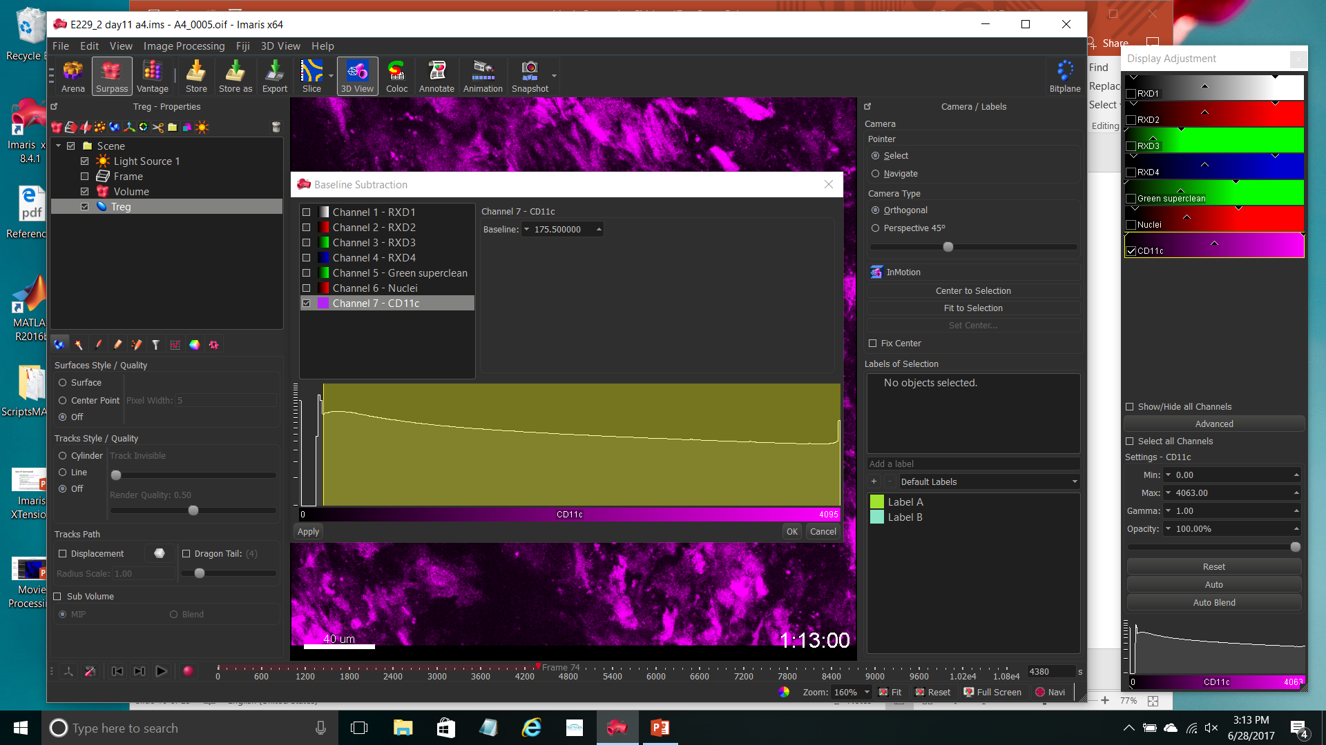
5. CREATE SURFACE OF CD11C CELLS (Baseline subtraction cleanup)

Slide 17
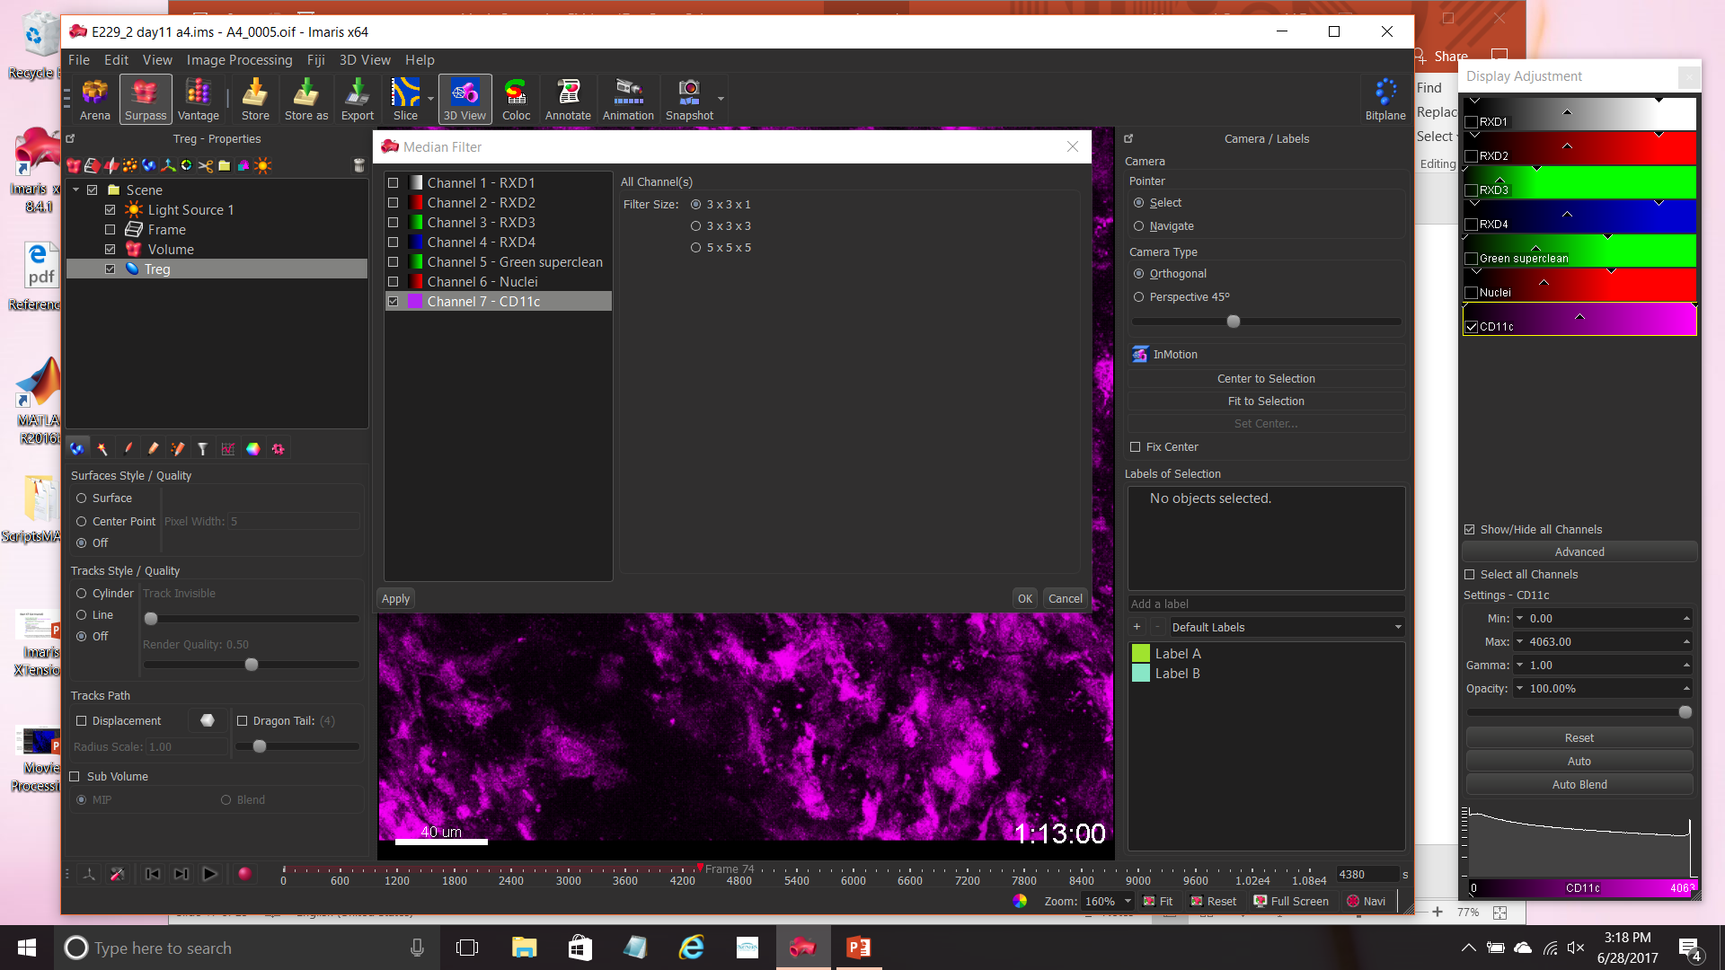
5. CREATE SURFACE OF CD11C CELLS (Median filter cleanup)

Slide 18
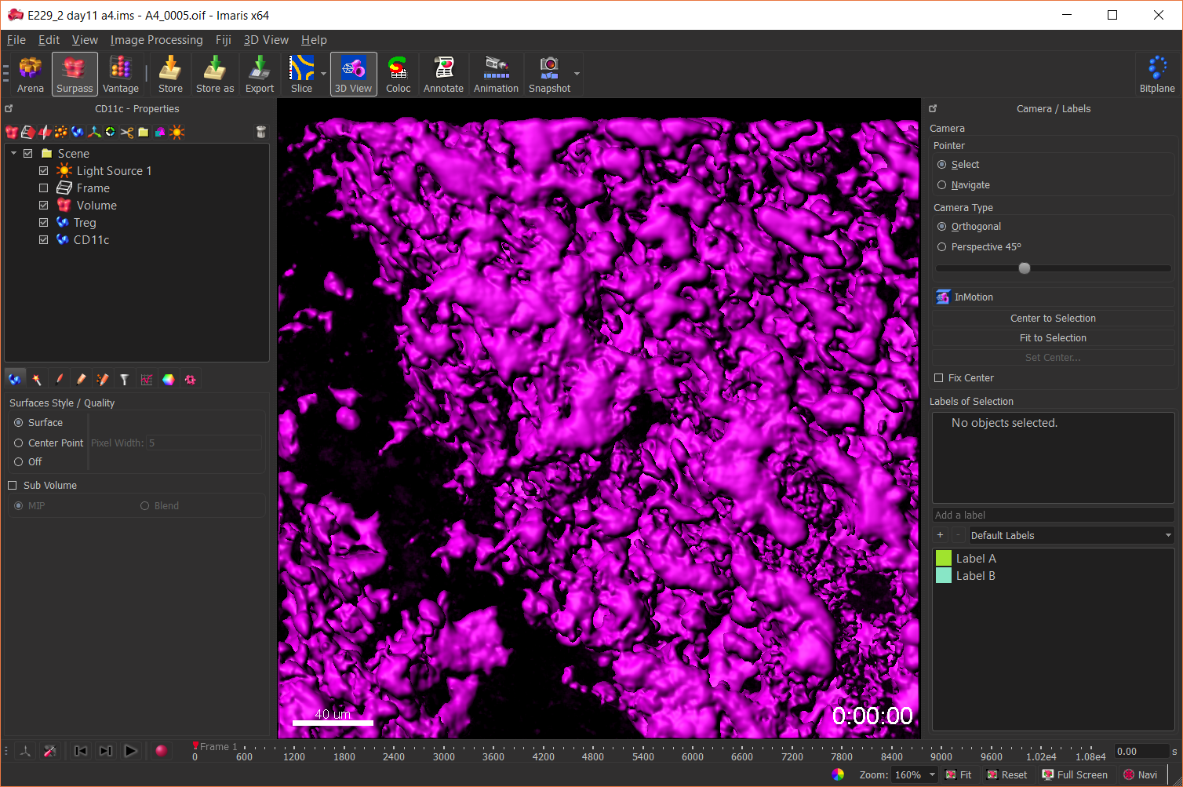
5. CREATE SURFACE OF CD11C CELLS

Slide 19
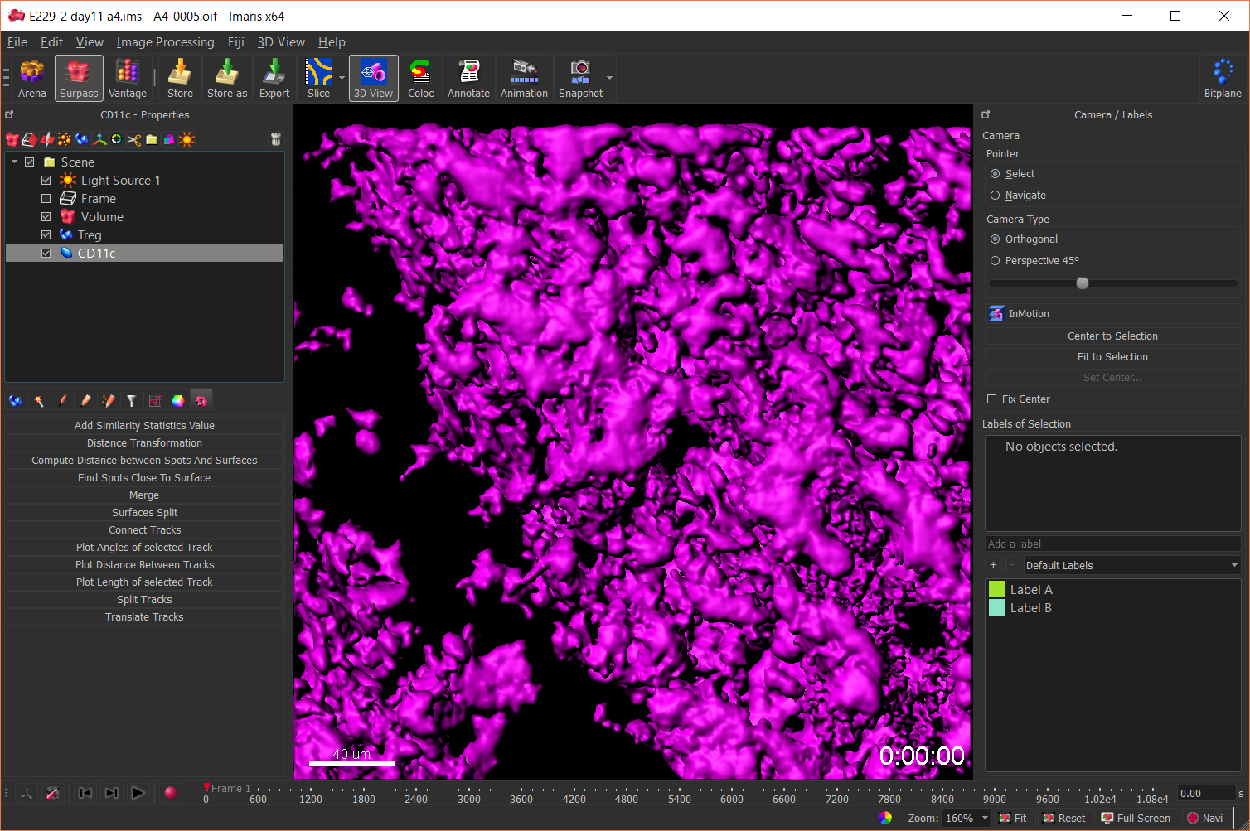
6. CALCULATE DISTANCE TRANSFORMATION FROM CD11C CELLS
Select CD11c surfaces,
Call Distance Transformation
“outside surfaces”
(takes time)

Slide 20
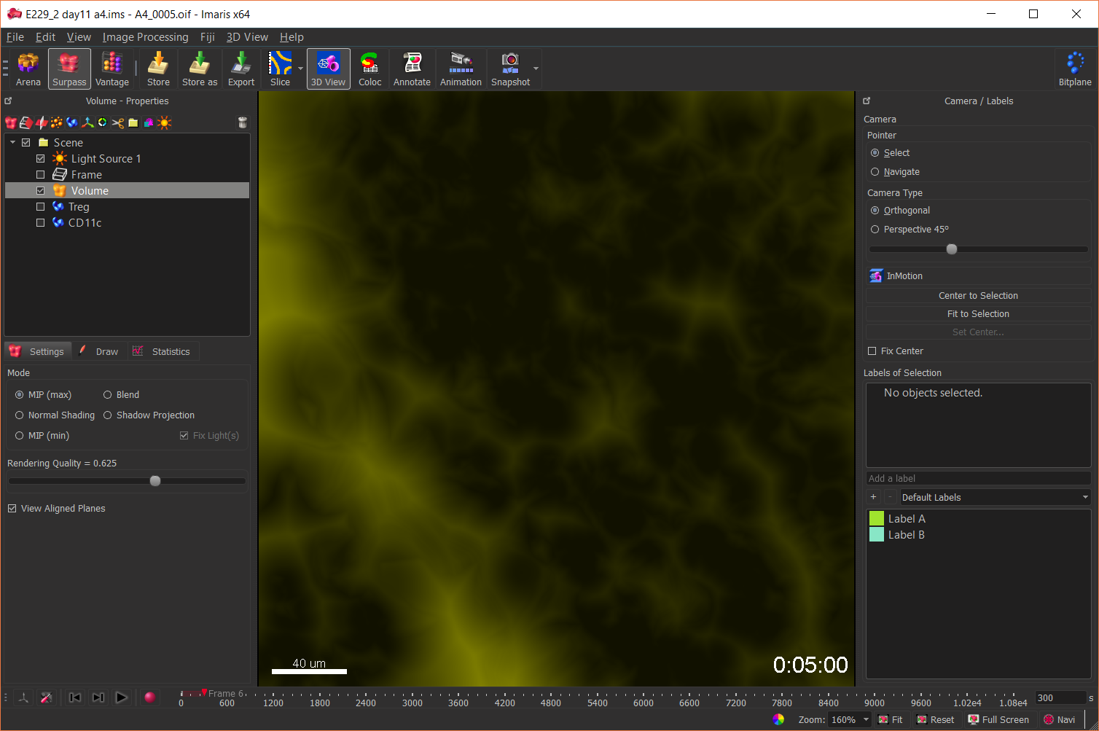
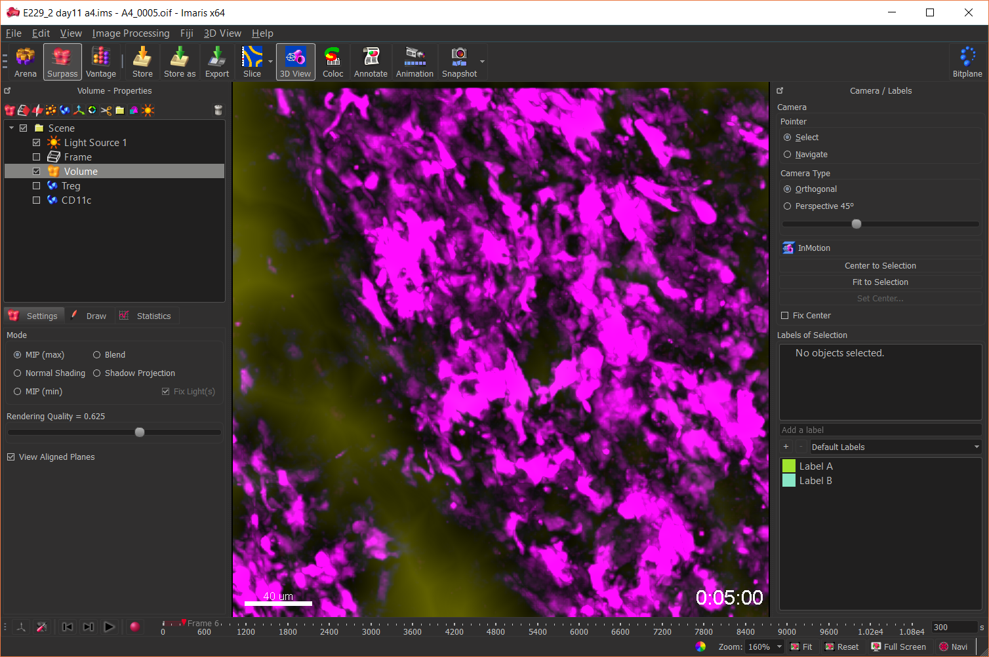
6. DISTANCE TRANSFORMATION FROM CD11C CELLS – END RESULT
Note exclusion of CD11c cells from Distance Transformation Channel (Yellow)

Slide 21
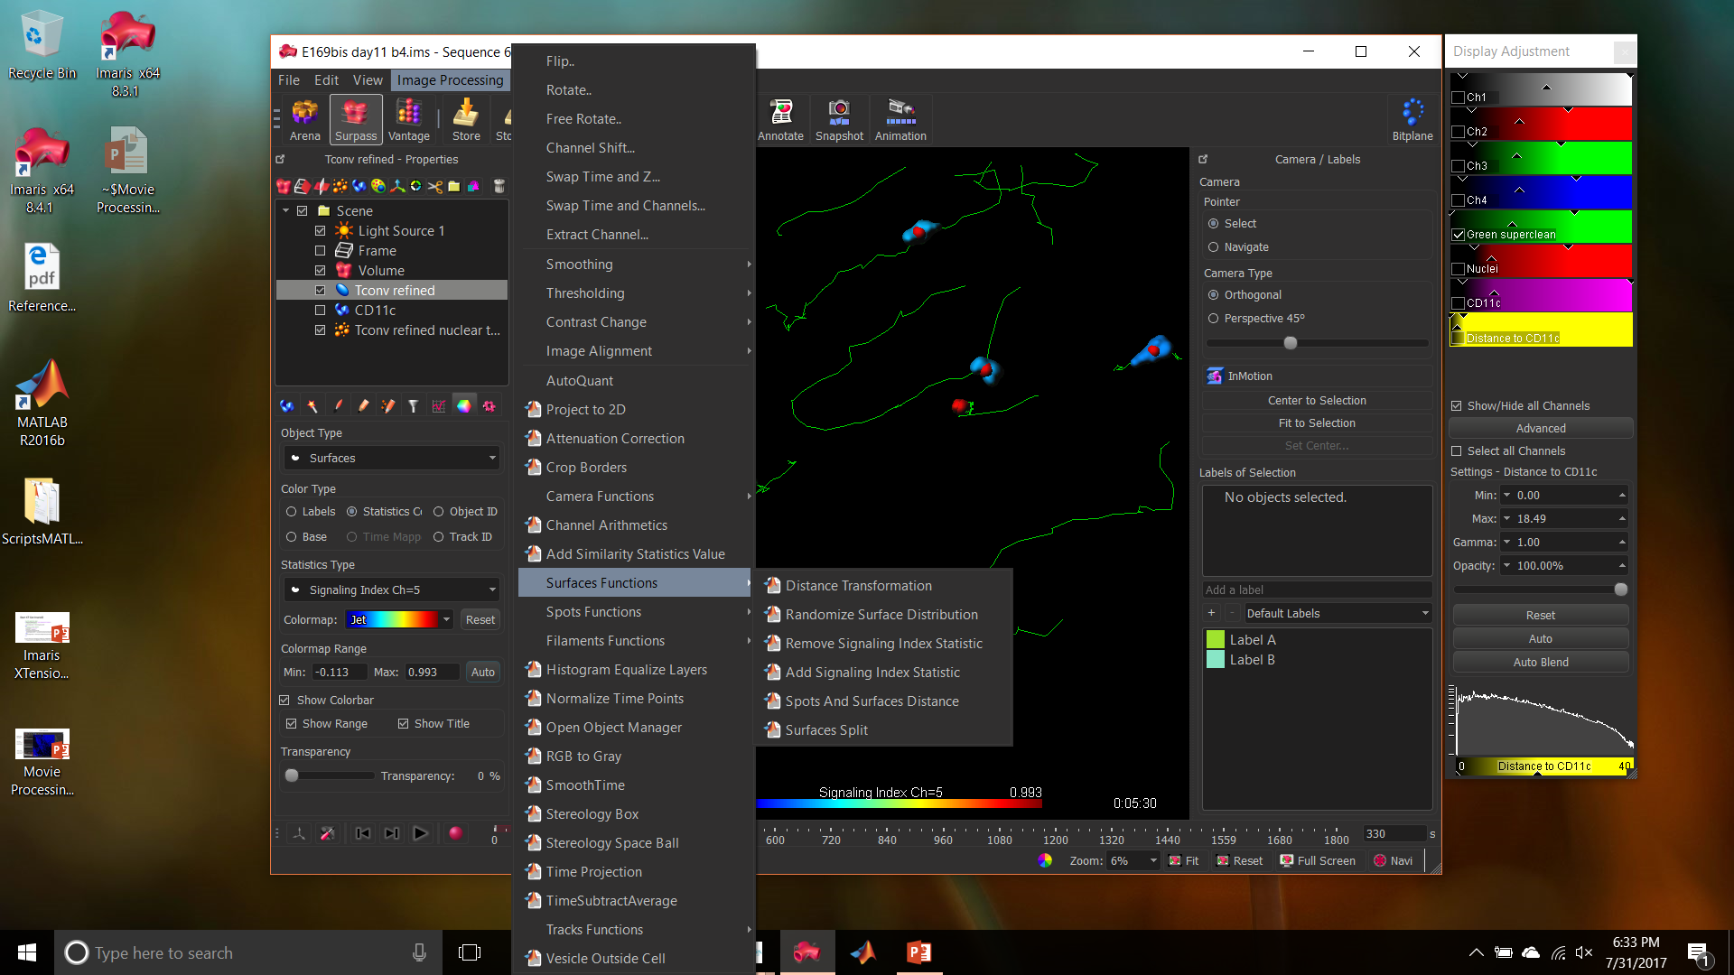
7. QUANTIFICATION OF NFAT ACTIVATION BY “CENTRAL ACCUMULATION”

Slide 22
7a. CENTRAL ACCUMULATION” ALGORITHM GLITCHES AND PATCHES
Algorithm does not like LABELS;
Algorithm does not tolerate deleting surfaces AFTER calculation of central accumulation;
Algorithm does not like Surface splitting, and even more surface MERGING.
If any of these instances occur, Imaris won’t match surfaces and spots while calculating Central accumulation (QC will fail).
PATCH GOOD FOR ALL PROBLEMS:
RESTART IMARIS

